Slide 1

Notes:
The purpose of this PowerPoint presentation is to show you some of the major differences in Word 2007 from the version we had here at school last year.

Slide 2

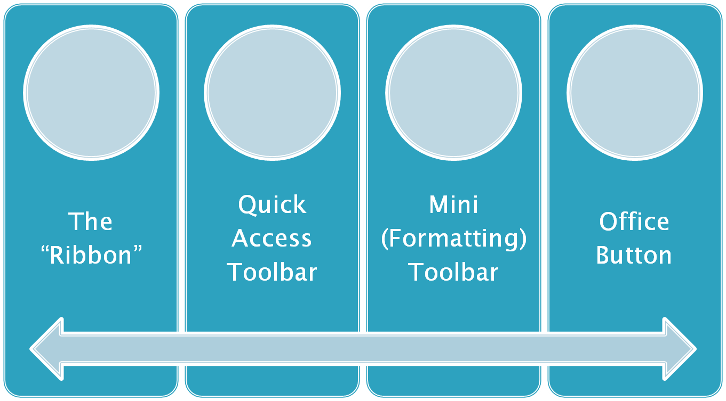
Notes:
Let’s talk about four Freaky Features in Office 2007. These are the ones that may slow you down at first because they are so unlike what we are used to. How freaky are they?
>

Slide 3




HOW FREAKY?
Notes:
They are this freaky!
The “Ribbon” – VERY freaky. There are none of the familiar drop-down menus in Word, Excel, and PowerPoint- they are replaced by the ribbon. It works differently and we will learn new places for old commands.
Quick Access Toolbar – Not very freaky, but a little disconcerting. A little explanation and it will become your new best friend.
Mini (Formatting) Toolbar- This one is scary only because it appears and disappears in a ghostly way. Are you afraid of ghosts? The freakiness of this feature depends on your answer!
Office Button- This one can really throw people for a loop because when you open Word 2007, for example, there’s no apparent way to open a document, to print a document, or to save a document. But by the end of this presentation you’ll understand the Office Button and these other features perfectly. (if you are paying attention! ) Ha!

Slide 4

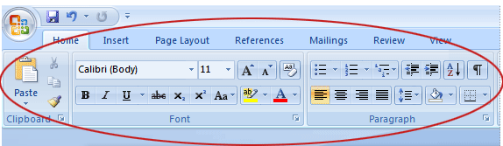
Notes:
The Ribbon! Very different. Looks pretty but how does it work?

Slide 5

Tabs
Groups
Commands
Dialog launcher
Notes:
There’s 4 main parts to the ribbon.

Slide 6

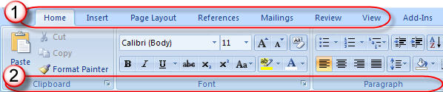
Notes:
Here are the first two parts: tabs across the top. Click a tab to see its contents. Then notice that each tab is divided into groups, shown along the bottom.

Slide 7

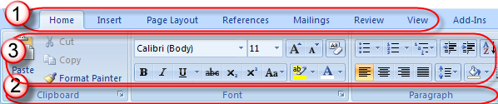
Notes:
Finally, on each tab, in each group, are the commands – represented by buttons usually, but also pull down selectors. Some buttons act immediately, other pop up additional choices.

Slide 8

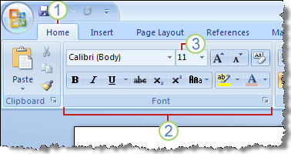
Notes:
Notice the Font Group?
As we learn and talk to each other about Office 2007 we will describe the location of commands this way: tab, group, and command. In other words, if someone asks where the font size command is, you answer, “On the Home tab, in the Font group, use the font size selector.”

Slide 9

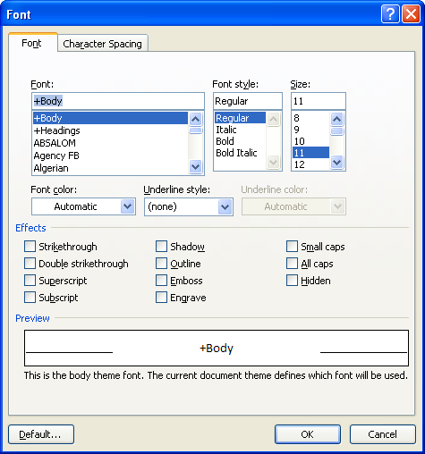
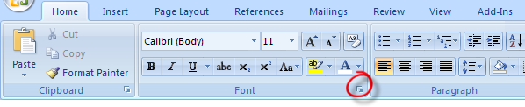
Notes:
All the most frequently-used commands are on the Home tab and each group shows its most common commands, too. But what if you are looking for something that’s not on the ribbon? Not everything is!
Let’s say you are a big fan of the ‘double-strikethrough’ format. There’s the Font group and there’s the strikethrough command, but Word has always had a little-used font effect – the double strikethrough. To see every possible option, click the dialog launcher button. This opens an ‘old-fashioned’ looking dialog box that displays everything. Note the tabs at the top of the window.

Slide 10

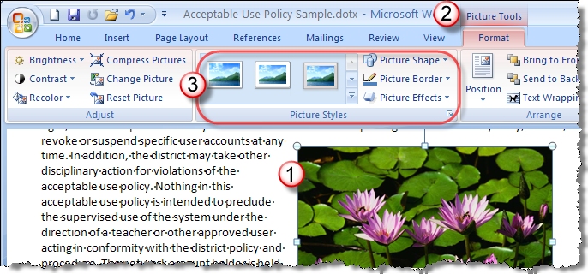
  Select the picture.
  The Picture Tools tab appears. Click it.
  Additional groups & commands appear, like Picture Styles.
Notes:
Contextual commands –are those that appear only when needed or appropriate. Example: insert a table, and the table-related tabs appear- table tools: design and layout. Table Tools disappear when you click out of your table. Same thing with Picture Tools and Chart Tools.

Slide 11

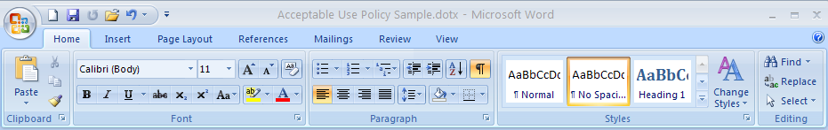
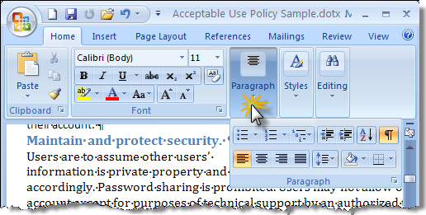
Ribbon commands do not change
In smaller windows, groups collapse into pop-up buttons
Notes:
Commands displayed & window width – one reason the new Office programs are easier to support is because everyone’s ribbon is the same. In older versions, people could make toolbars appear and disappear, even customize each toolbar. So it was impossible to say to someone, “look on your standard toolbar for this command” reliably. The ribbon has the same contents for every user, but it does change to accommodate the width of the window. Wide screen? You see lots of details, even labels for commands. SEE FIRST PICTURE. The most-used commands have the biggest buttons. Narrow window? Some commands grow smaller. NOTE SECOND PICTURE. Whole groups may be reduced to just a pop-up button. SUGGESTION IF TIME ALLOWS: DEMONSTRATE by stopping the show, resizing the window, and noting the changes in the ribbon.

Slide 12

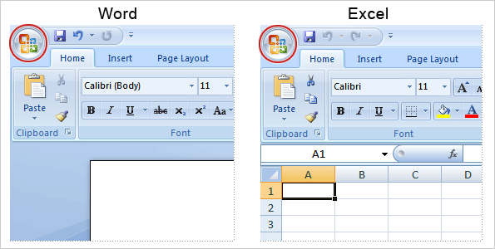
Notes:
The Office Button in the upper left hand corner is more than just a decoration. It takes the place of the “File” button from last year. It offers you options, such as saving, printing, etc.

Slide 13
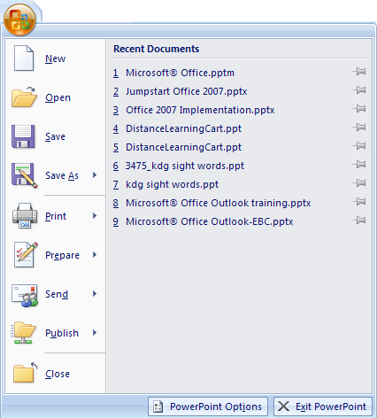
File menu plus
In and Out of Office
Recent Docs
Note options
Notes:
It also shows the recent documents you have worked on in a list format.

Slide 14

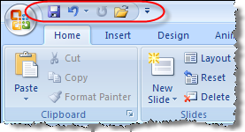
Save, undo, redo
Show above/below ribbon
Drop down menu to add commands
Notes:
This is located right next to the Office Button.

Slide 15
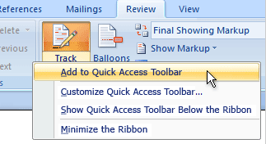
Or, right-click any command
Notes:
You can add other commands to the quick access toolbar by right clicking on it. An example might be adding spell check for quick access.

Slide 16

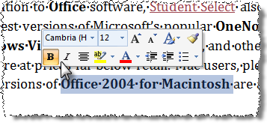
Select text, move cursor, see ghostly mini toolbar!
Another way to bring frequent commands closer and faster

Slide 17
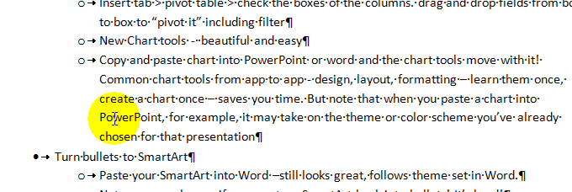
Select text, move cursor, see ghostly mini toolbar!
Access frequent commands faster

Slide 18


Notes:
The features that we have talked about are common to Word, PowerPoint, and Excel.
Now you know what these features are so go ahead and start using them.

